Slide 1

Imblearn
A look Beyond Over Sampling

Slide 2



Leandro Ferreira
/ferreiramleandro
@leozimmelo
/leandromferreira

Slide 3
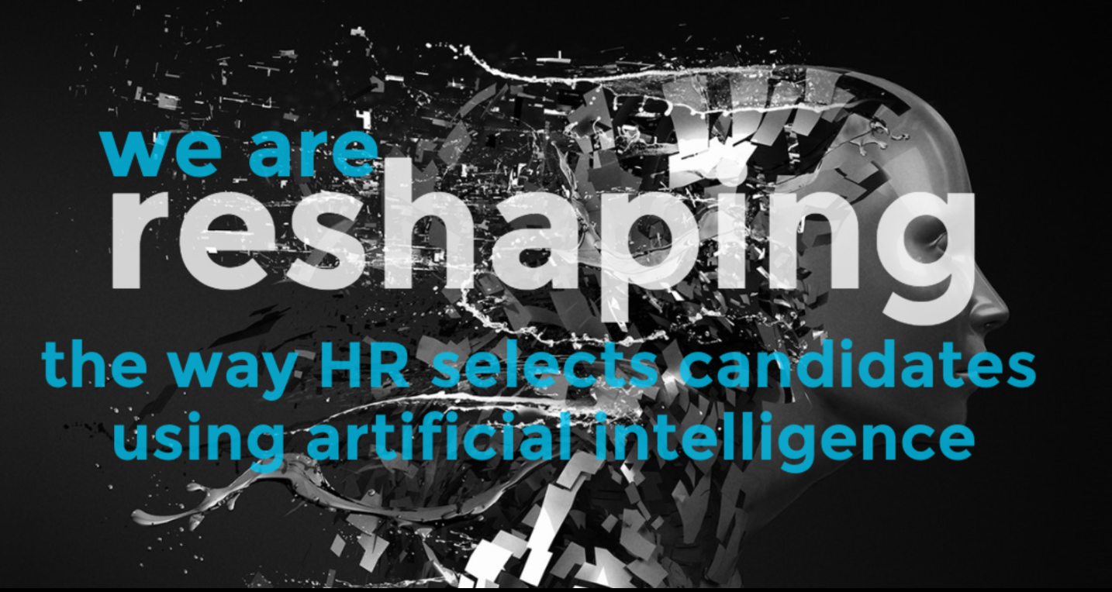

Slide 4
imblearn
Version: 0.4.3
Started at 2014
Compatible with scikit-learn
Docs: https://imbalanced-learn.readthedocs.io/

Slide 5
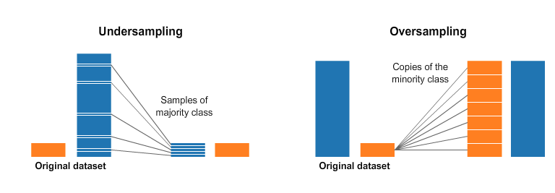
Resampling
Source: Resampling Strategies for Imbalanced Datasets

Slide 6
Over VS Under Sampling
Can cause Overfitting
Discart useful information

Slide 7
Over Sampling Techniques
Random Over Sampling
SMOTE (Synthetic Minority Over Sampling technique)
ADASYN (Adaptive Synthetic Sampling Approach)

Slide 8
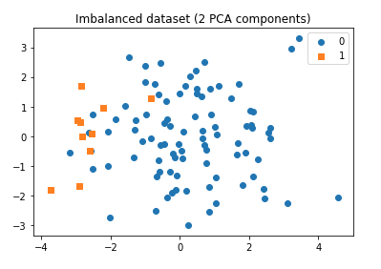
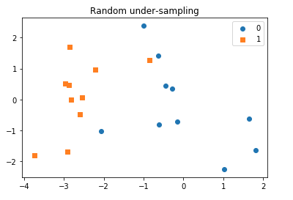
Random Under Sampling

Slide 9
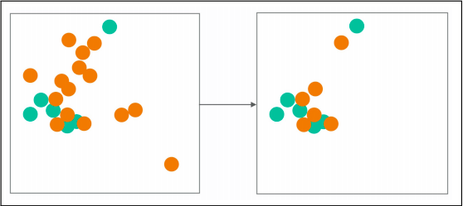
Near Miss
1: Retain points for the majority class whose mean distance to the k nearest point in minority class is lowest

Slide 10
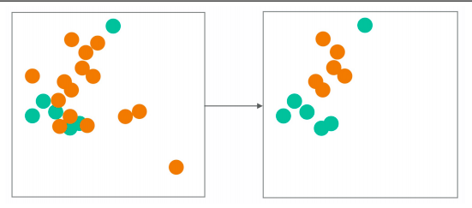
Near Miss
2: Keep points of the majority class whose mean distance to the k farthest points in the minority class

Slide 11
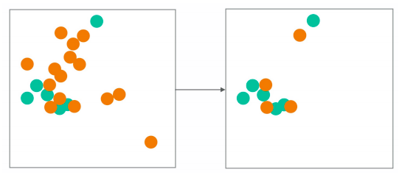
Near Miss
3: Select K nearest neighbors in the majority class for every point in the minority class

Slide 12
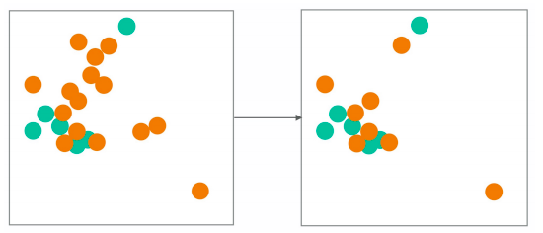
Condensed NN

Slide 13
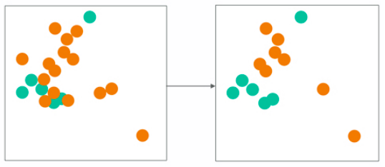
Edited NN

Slide 14
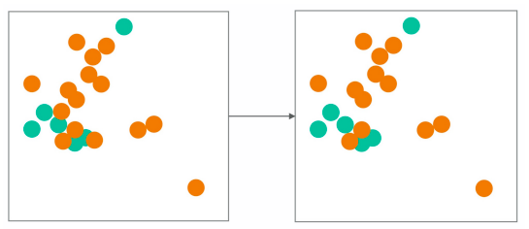
Repeated ENN

Slide 15
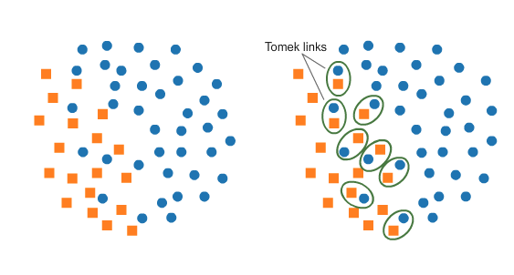
Tomek Links
Source: Resampling Strategies for Imbalanced Datasets

Slide 16
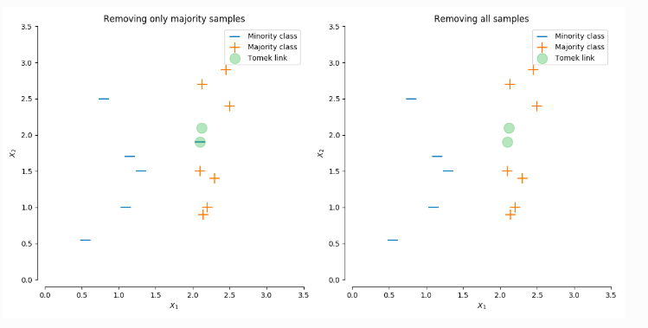
Tomek Links

Slide 17
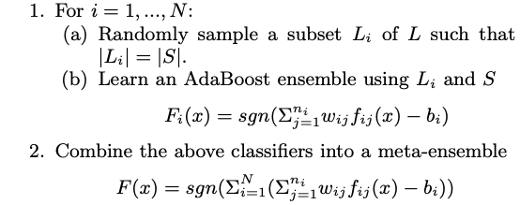
Easy Ensemble

Slide 18
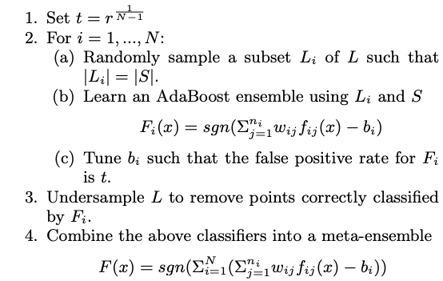
Balance Cascade

Slide 19
Ensemble Methods
AllKNN
Instance Hardness Threshold
Neighbourhood Cleaning Rule
One Sided Selection

Slide 20
Ensemble Methods Classifier
Balanced Random Forest Classifier
Balanced Bagging Classifier
Easy Ensemble Classifier
RUS Boost Classifier

Slide 21
Combine
SMOTE+ENN
SMOTE+TOMEK

Slide 22
References and helpful links
[Article] Survey of resampling techniques for improving classification performance in unbalanced datasets
[PyData Talk] Ajinkya More | Resampling techniques and other strategies
[Article] Exploratory Undersampling for Class-Imbalance Learning
[PyData Talk] Imbalanced Data, Mehrdad Yazdan
[Article] Evaluation Measures for Models Assessment over Imbalanced Data Sets

